Slide 1
Commute times in the US and its effects

Slide 2
What are the cities or areas in the US with longer commute times?

Slide 3
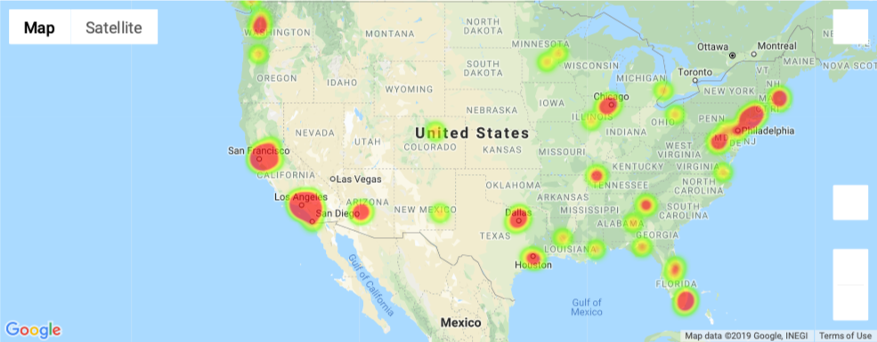

Slide 4
What are the correlations between commute times income and quality of life in 2017?

Slide 5
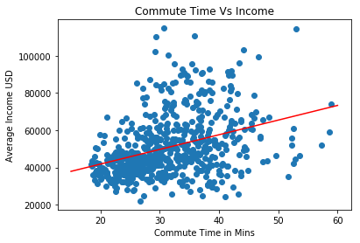

Slide 6
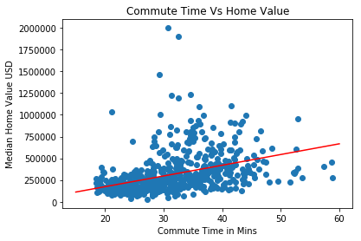

Slide 7
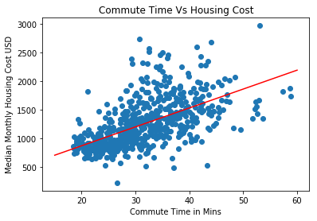

Slide 8
Was there a change or noticeable trend when comparing data with the previous 4 years?

Slide 9
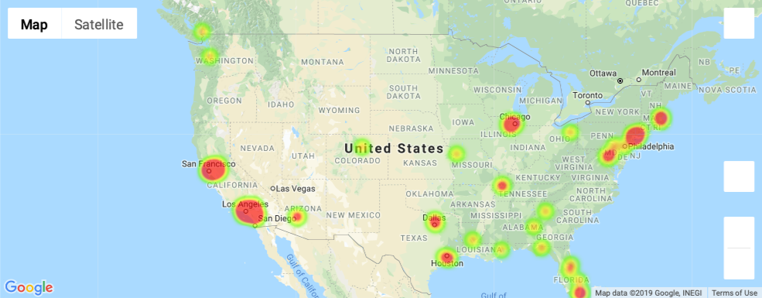
2013
2017

Slide 10
